Slide 1
Neural Book Recommendation System
By Vaibhav Sareen

Slide 2
Problem Statement
To design and build a recommendation system model for an e-commerce platform.

Slide 3
Data Insights
The data that has been used in this proof of concept is ‘Book Crossing Dataset’ from Kaggle.
Initial data was split into 3 separate files containing information about the user, book and the user rating for the books which have been merged into a single file for the purpose of training the model.
User and book features have been categorised into implicit information features.
For the demo purpose information related to a single country Canada is used.
This dataset is used to create a book recommendation system by ranking the output for the model based on its probability score.

Slide 4
Data Insights
The dataset used for the training of the model contains features such user’s age, city, state and country it lives in and book’s publisher, author and year of production.
It also contains user’s rating for the book.
The above data has been pre processed into implicit categorical features and transformed into simpler categories to be used to train the model

Slide 5
Model Approach
The model takes inspiration from the research papers ‘Neural Collaborative Filtering’ [2017] by Xiangnan He, Lizi Liao et al and ‘Attention Is All You Need’[2017] by Ashish Vaswani, Noam Shazeer et al
The model used is an attempt at combining research from both of the above papers and improving it.
The model does not need to create and use user-user, item-item or user-item sparse matrix.
The model does not use large sparse embeddings but smaller dense embeddings.
The model used here is a base line model which is smaller than Bert in terms of size and has a smaller embedding dimension size in order to create a simple baseline model which can be scaled down or up easily.
This is a model based hybrid approach utilizing the power of transformer’s encoder and simple feedforward neural network layers.

Slide 6
Model Approach
The approach is an attempt to understand the relationship between the auxiliary information stored in the provided user’s and book’s implicit information features.
A neural network approach is taken over simpler heuristic approaches such as collaborative filtering, content based recommendation and traditional machine learning methodology based model approaches as we are able train a function which can approximate the relationship between the information related to the model and can be retrained on more data and the architecture can be modified without creating the model from scratch.

Slide 7
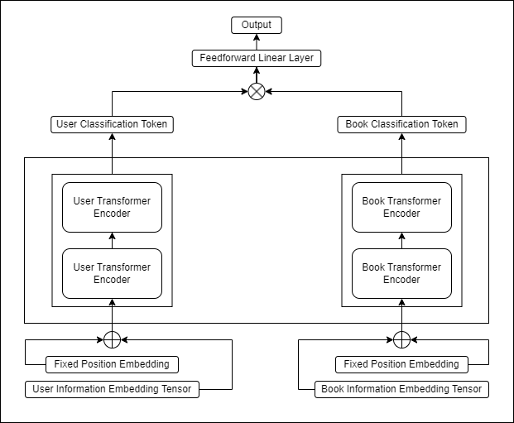
Model Architecture

Slide 8
Model Training & Performance Details
The model uses fixed sinusoidal and cosine positional embedding.
The embedding dimension to store information related to the user and book is set at 64
The feedforward layer dimension for each encoder layer is set at 512
Each encoder uses 4 mutli-self-attention heads.
A single feedforward layer is used to predict the output probabilities
The model was trained on a training dataset containing approximately 72000 pairs of user book information.
The model was trained for 300 epochs with a learning rate of 3e-3 and with a batch size of 512 over a single 3070 GPU which took about 78 minutes to complete.
The model was validated on a smaller dataset obtained from the training dataset of size 2024
The model was able to predict the ratings for the user book pairs in the dataset with an accuracy of 89.9% through CPU inferencing in roughly 0.8 seconds

Slide 9
Limitations and Further Improvements
Due to model’s smaller size the model had to be trained for a long duration than it should have.
The model can be further improved by increasing the input embedding dimension to 128, 256, 512 or 768.
More number of encoder can be added to improve the generalization of the model
More and better features can be used to train the model to understand and learn the complexity of the data.
A better approach can be used to better utilize the output of the encoders

Slide 10
Links and citations
Book Crossing Dataset - https://www.kaggle.com/datasets/syedjaferk/book-crossing-dataset
Neural Collaborative Filtering - https://arxiv.org/pdf/1708.05031.pdf
Attention Is All You Need - https://arxiv.org/pdf/1706.03762.pdf

Slide 11
THANK YOU!

